Slide 1
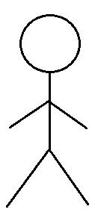
Use Case Diagram
MaidEase
Use Case Diagram
Module: 01. Account Management
1.1 Create a user account
1.2 Authenticate Account
1.3 Update Account
1.4 Maintain Account Summary
User
1.5 Close Account
Service Provider
1.6 Track loyalty

